Slide 1

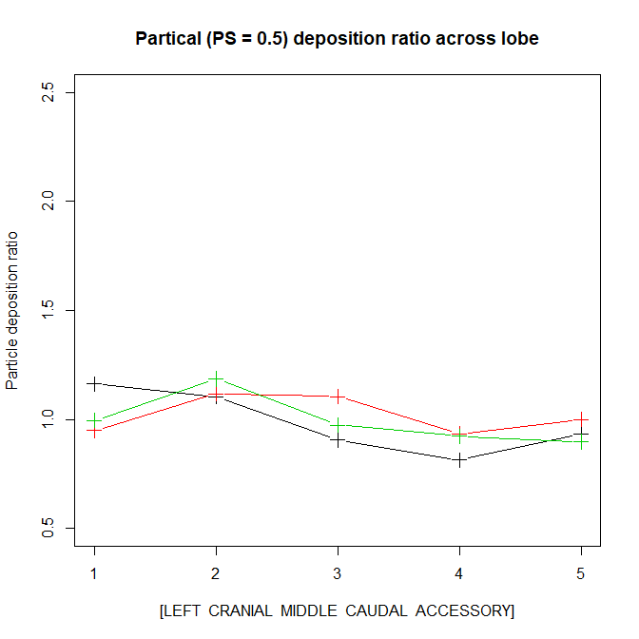
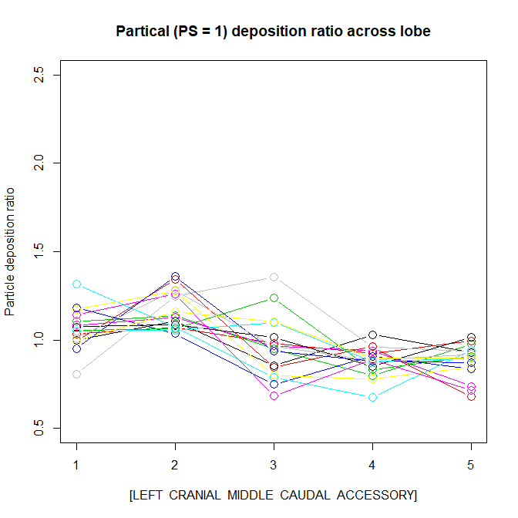
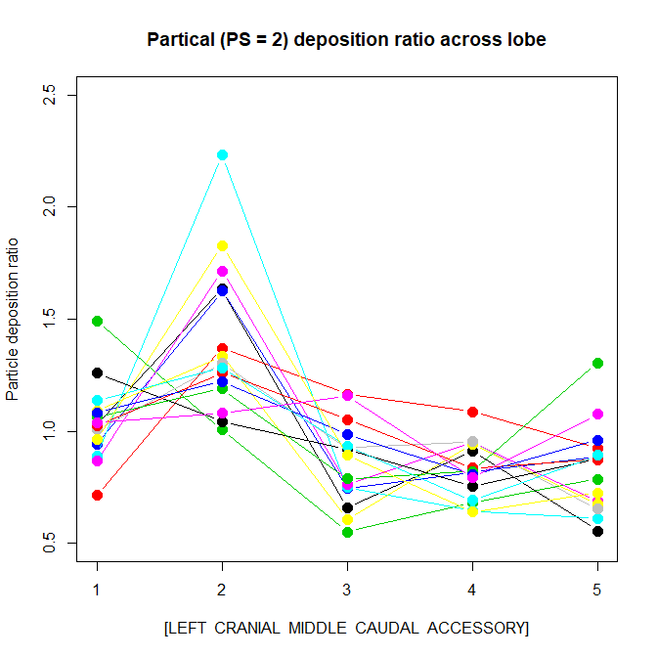
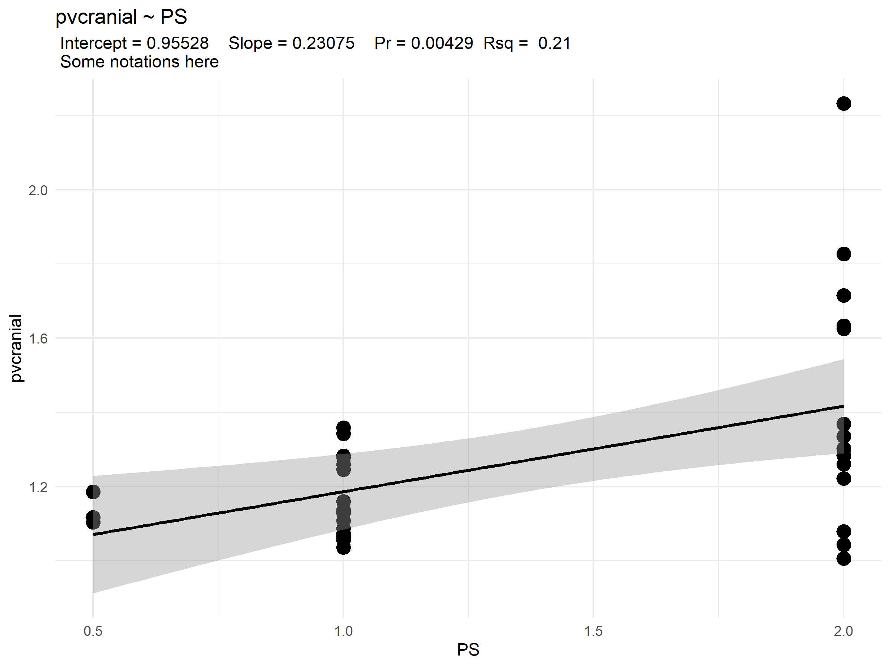
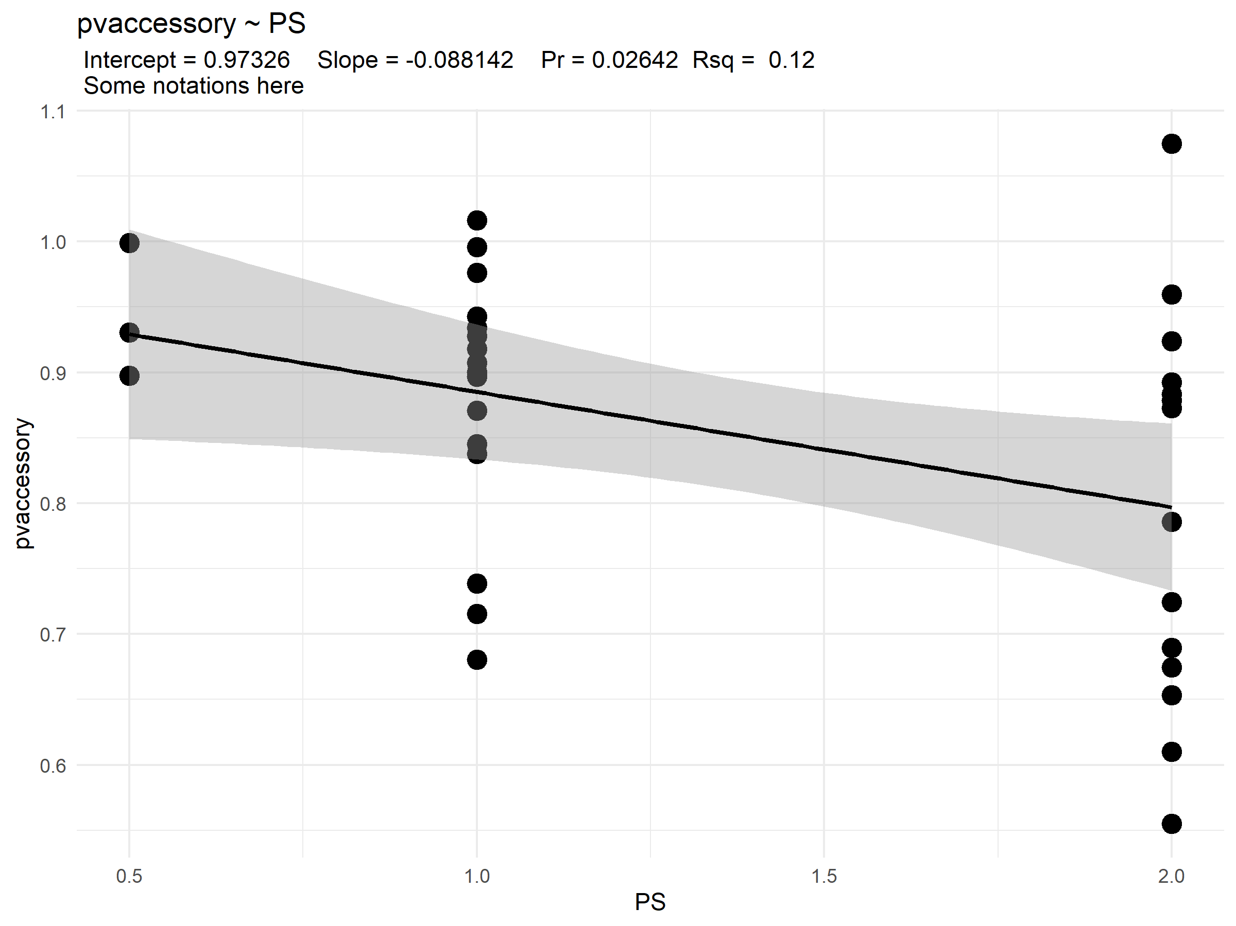
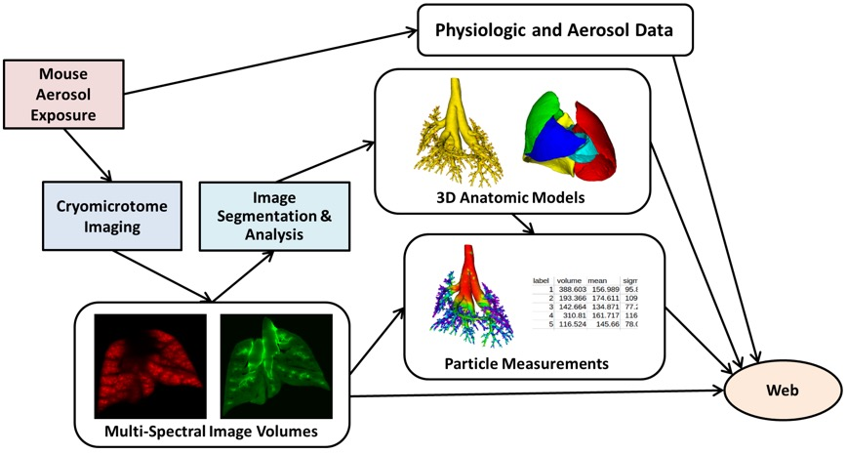
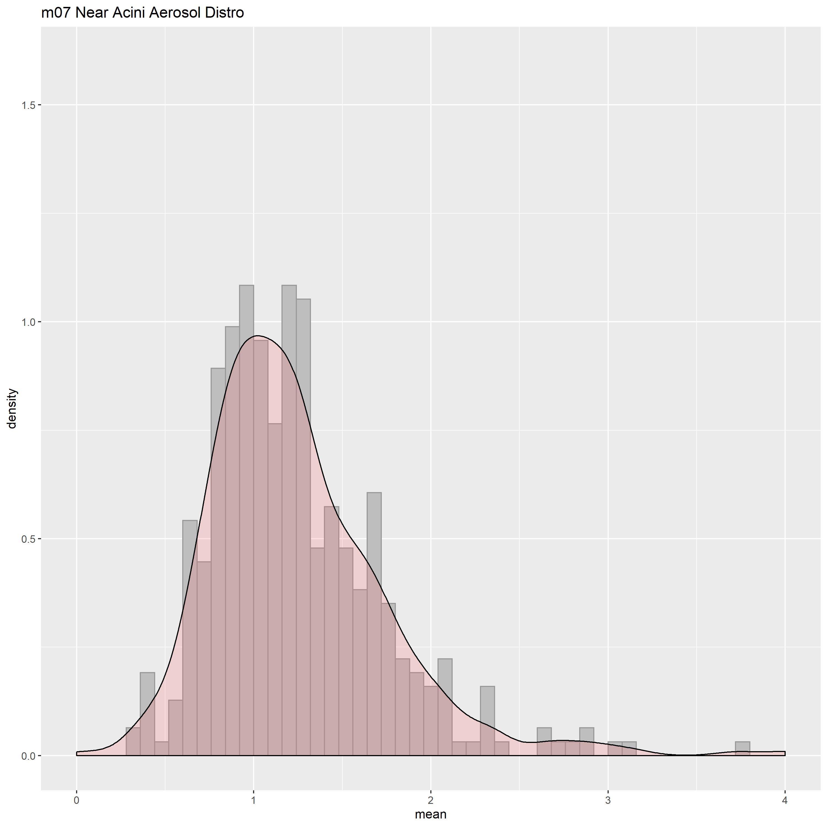
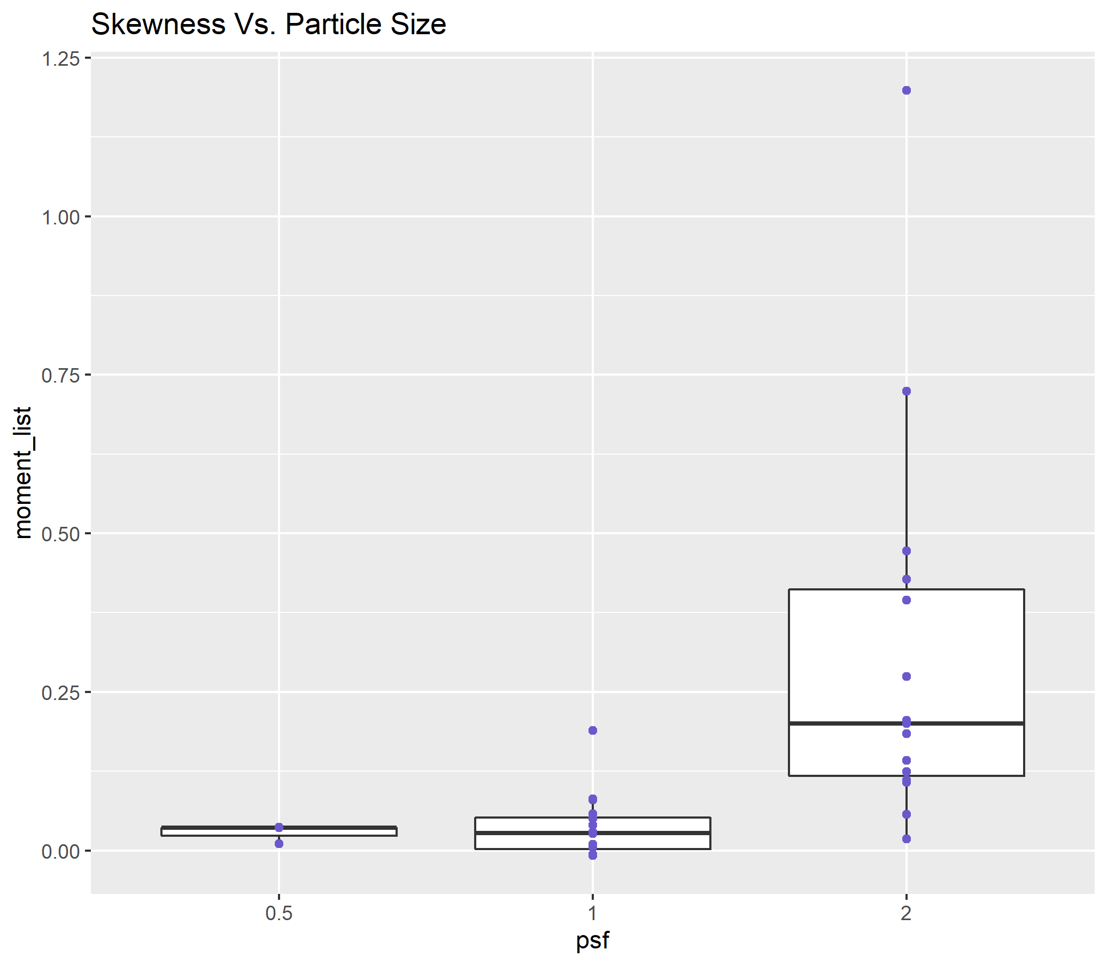
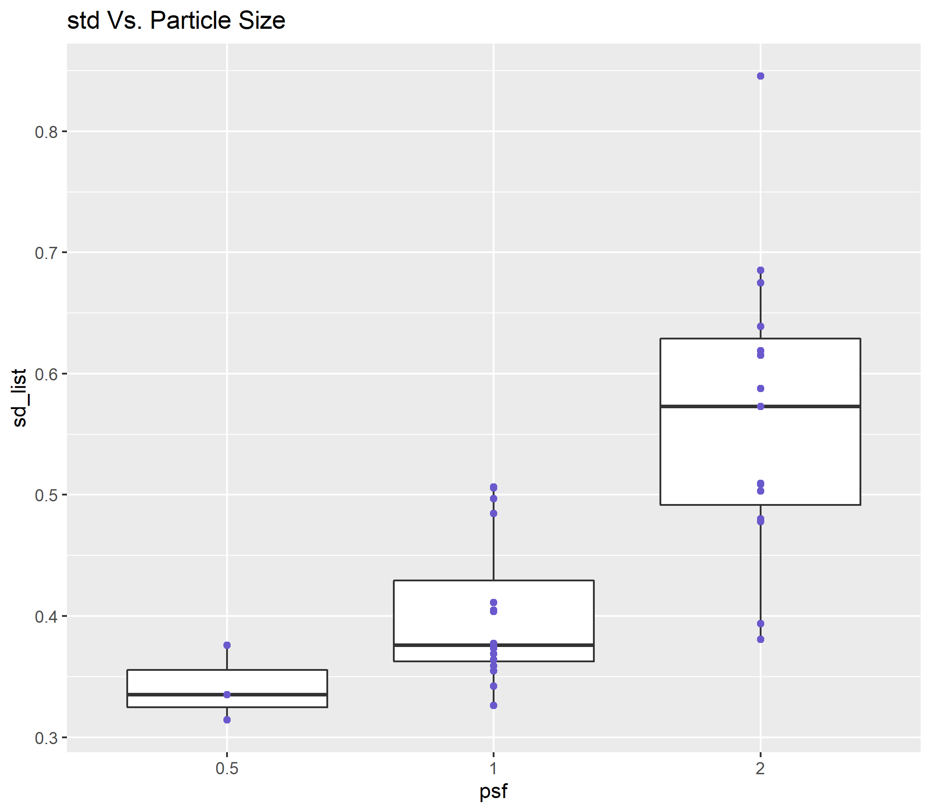
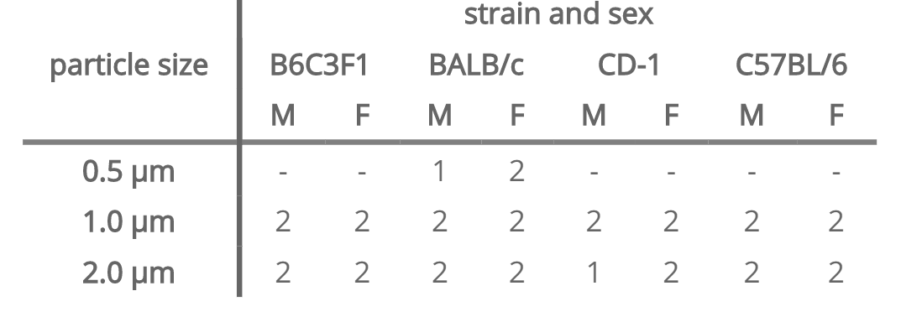
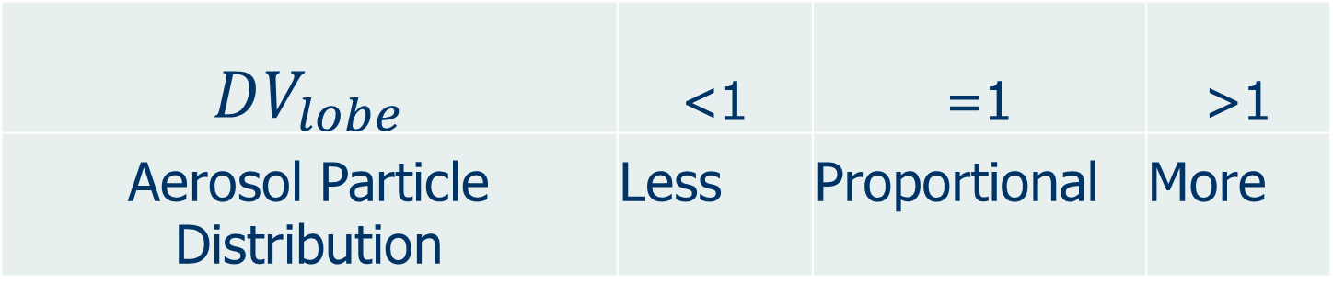

Lobar deposition of inhaled aerosol in the mouse lung: preliminary analysis of the LAPD dataset Wanjun Gu, Chantal Darquenne Department of Medicine, University of California, San Diego
BACKGROUND
RESULTS AND DISCUSSION
Aerosol-inhalation drug delivery research, due to its potential health risk, is usually carried out on laboratory animals, most commonly mice.
A unique database, Lung Anatomy + Particle Deposition Mouse Archive (LAPD:) has been recently made available to the research community. This dataset includes both high resolution lung anatomy and deposition data in four strains of mice.
One of the major constraints of previous studies in this field has been lack of data on both lung anatomy and deposition distribution in the same animals.
Heterogeneity in particle deposition increases with respect to increasing particle size
Evenness disappear with increasing PS
OBJECTIVES
To identify spatial heterogeneity of aerosol deposition in lung on a lobar scale and determine correlations between the heterogeneity and particle size.
METHODS
LAPD Study Overview:
From: https://doi.org/10.25820/9arg-9w56
Available datasets:
Heterogeneity in particle deposition increases with respect to increasing particle size
Evenness disappear with increasing PS
From: https://lapdmouse.iibi.uiowa.edu/Data/
Current Study - Deposition Data Normalization (Lobar Level)
Lobar deposition (volume) was normalized by the sum of deposition (volume) in each of the five lobes. A ratio of normalized deposition over volume was then taken for each lobe for each animal.
$DV_{lobe}=\frac{\frac{D_{lobe}}{D_{total}}}{ \frac{V_{lobe}}{V_{total}} }$
CONCLUSIONS AND NEXT STEPS
We performed our analysis of the newly available database …
There was an uneven distribution of deposited particles among the lobes of the mouse lung. The unevenness increases with increasing particle size. depending on the lobe, individual lobe analysis to determine overall deposition may either underestimate or overestimate total lung burden, at least for particles in the micron size range.
At near acini level, larger particle size is associated with higher likeness of formation of hot spots and a less uniform spatial distribution of particle deposition.
There was no significant difference in strain and gender. we put all data together (Discussion)
$$DV_{lobe}$$ | <1 | =1 | >1
Aerosol Particle Distribution | Less | Proportional | More
Current Study – Spatial distribution of deposited particles near acini
Outliers, 3rd moment and std, skewness is a measure of the presence of hot spots

